Slide 1


Green Pace
Security Policy Presentation
Developer: John Schatzl
Implementation Guidelines and Future Recommendations

Slide 2

OVERVIEW: DEFENSE IN DEPTH
Why A Security Policy?
Growing Complexity and Team size
Purposes of the Policy
Ensure every developer adheres to proven security principles.
Create a repeatable, measurable, and auditable process.
Support a Defense-in-depth strategy by layering multiple security controls.
Defense-In-Depth Explained
Our approach safeguards critical systems by deploying multiple, independent security measures. Even if one layer is breached, others remain to protect the system.

Slide 3
THREATS MATRIX
Likely STD-004-CPP STD-008-CPP STD-010-CPP | Priority STD-001-CPP STD-002-CPP STD-003-CPP STD-004-CPP STD-005-CPP STD-007-CPP STD-010-CPP
Low Priority STD-006-CPP STD-008-CPP STD-009-CPP | Unlikely STD-001-CPP STD-003-CPP STD-009-CPP
This matrix separates each security principle by its associated likelihood, and priority to separate our concerns.

Slide 4
10 PRINCIPLES
Validate Input Data
STD-001-CPP, STD-002-CPP, STD-003-CPP, STD-004-CPP, STD-008-CPP
Heed Compiler Warnings
STD-001-CPP, STD-006-CPP, STD-010-CPP
Architect and Design For Security Policies
This principle applies to the overall system design rather than specific coding standards.
Keep it Simple
This principle applies to the overall system design rather than specific coding standards.
Default Deny
This principle applies to the overall system design rather than specific coding standards.
Adhere to the Principle of Least Privilege
STD-002-CPP
Sanitize Data Sent to Other Systems
STD-004-CPP, STD-009-CPP
Practice Defense in Depth
STD-005-CPP, STD-007-CPP
Use Effective Quality Assurance Techniques
STD-003-CPP, STD-006-CPP, STD-008-CPP, STD-009-CPP
Adopt a Secure Coding Standard
STD-001-CPP, STD-005-CPP, STD-007-CPP, STD-010-CPP

Slide 5
CODING STANDARDS
Priority | Coding Standard | Label | Description
1 | SQL Injection | STD-004-CPP | Prevent unwanted manipulation of backend databases
2 | Pointer Safety | STD-010-CPP | Enforce safe use of pointers
3 | Data Type | STD-001-CPP | Ensure strict typing
4 | Data Value | STD-002-CPP | Check data for out-of-bounds violations
5 | String Correctness | STD-003-CPP | Protect inputs
6 | Memory Protection | STD-005-CPP | Prevent memory leaks
7 | Exception | STD-007-CPP | Enforce exception catching
8 | File Handling | STD-008-CPP | Enforce proper file handling
9 | Assertions | STD-006-CPP | Use assertions mainly in development
10 | Logging | STD-009-CPP | Enforce non-sensitive logging

Slide 6
ENCRYPTION POLICIES
Encryption at Rest
Protects data stored on physical media by converting it into a secure format that is unreadable without the appropriate decryption key.
It is used through disk encryption, database encryption and file-level encryption.
Applies to any stored sensitive data to mitigate the risk of data breaches resulting from unauthorized physical or network access.
Encryption in Flight
Secures data as it moves across networks using protocols such as TLS/SSL.
It is used through HTTPS, VPNs, secure email.
This policy ensures that data sent between clients, servers, or across distributed systems is protected from interception or tampering during transmission.
Encryption in Use
Protects data while it is being processed using techniques like homomorphic encryption or secure enclaves.
It is used by processing sensitive data in secure enclaves, performing computations on encrypted data.
It applies because it minimizes exposure of sensitive data during processing, ensuring that even if an application or system is compromised, the data being used is not readily accessible in plaintext.

Slide 7
TRIPLE-A POLICIES
Element | Description | How it is Used | Why and When the Policy Applies
Authentication | Verifies the identity of a user or system. | Multi-factor authentication, strong passwords, biometrics. | Mandates robust authentication mechanisms to ensure that only authorized individuals can access systems. This is vital for protecting user logins and preventing unauthorized access.
Authorization | Determines the level of access and permissions an authenticated user has within a system. | Role-based access control, access control lists. | Enforces strict authorization policies to ensure that users can perform only those actions that are essential for their role. This controls changes to databases, the addition of new users, and restricts access to sensitive files or system functions.
Accounting | Tracks and records user activities, changes, and access within the system. | Audit logs, security information and event management (SIEM) systems. | Requires comprehensive logging and audit trails for all key actions, such as file accesses, modifications, logins, and changes to user privileges. This ensures traceability, supports incident investigations, and helps maintain accountability across the system.

Slide 8
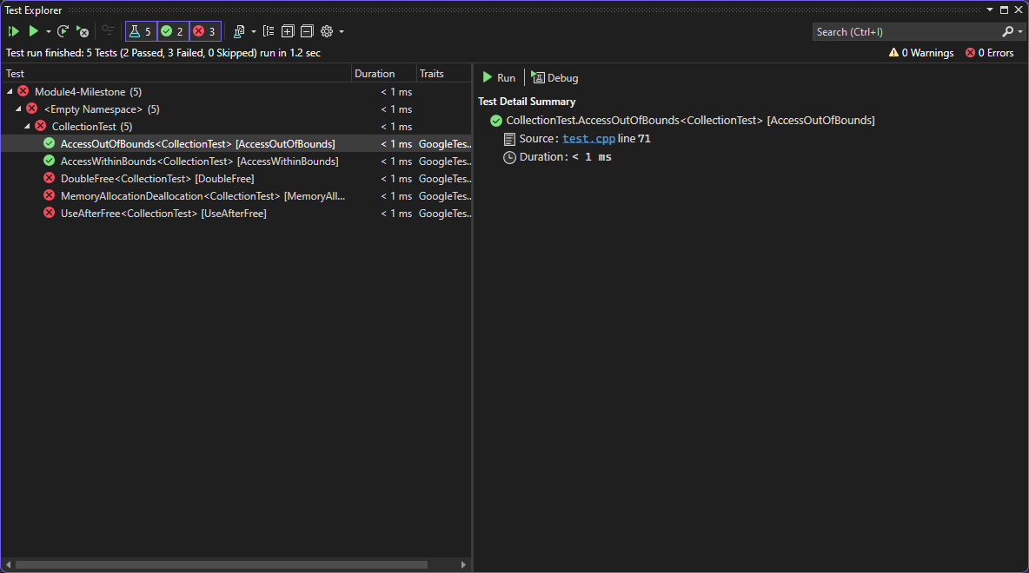

Unit Testing
Unit Test – AccessWithinBounds
To verify that accessing an element within the bounds of the collection does not throw an exception.
Helps to consider edge cases, such as accessing the first and last elements.

Slide 9
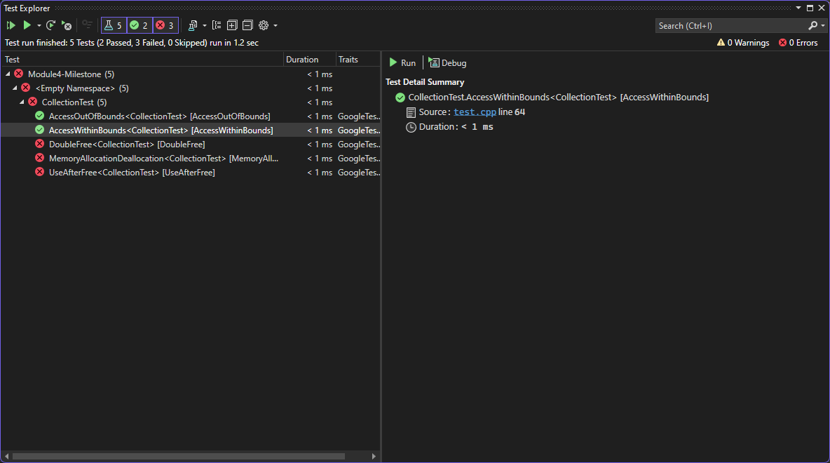

Unit Testing
Unit Test – AccessOutOfBounds
To verify that accessing an element out of bounds throws an std::out_of_range exception.
Consider edge cases like accessing an index one position beyond the valid range.

Slide 10
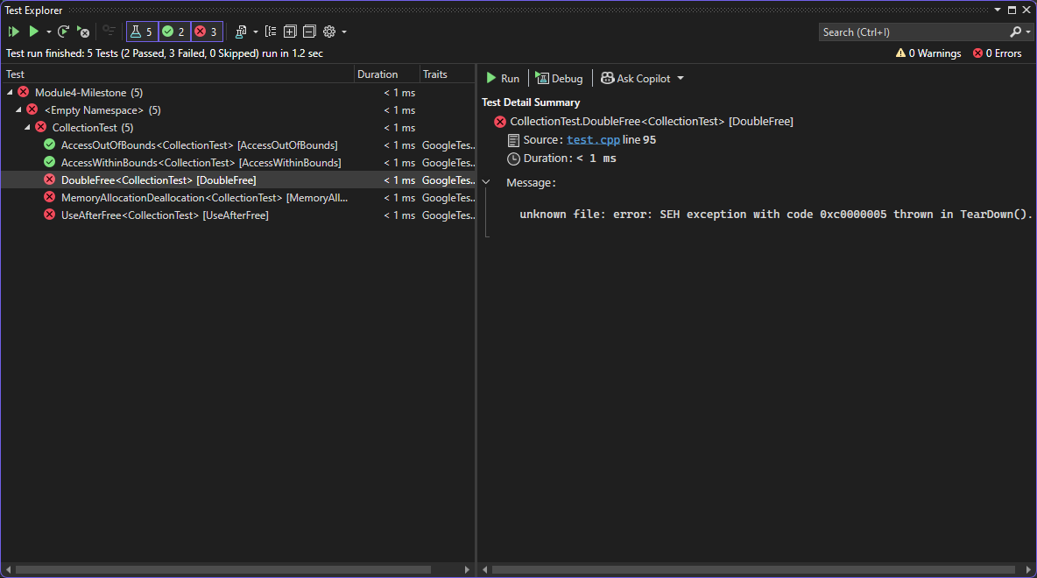

Unit Testing
Unit Test - MemoryAllocationDeallocation
To verify that memory is properly allocated and deallocated when using a smart pointer.
Also helps to test with other object types, not just vector.

Slide 11
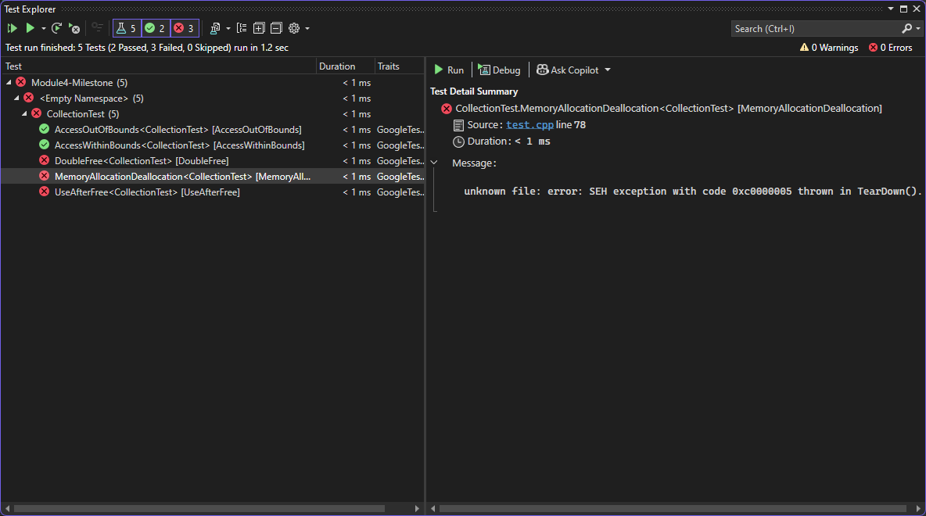

Unit Testing
Unit Test - UseAfterFree
To verify that a use-after-free error is prevented.
Also good to test with other methods of the deallocated object, not just at()

Slide 12
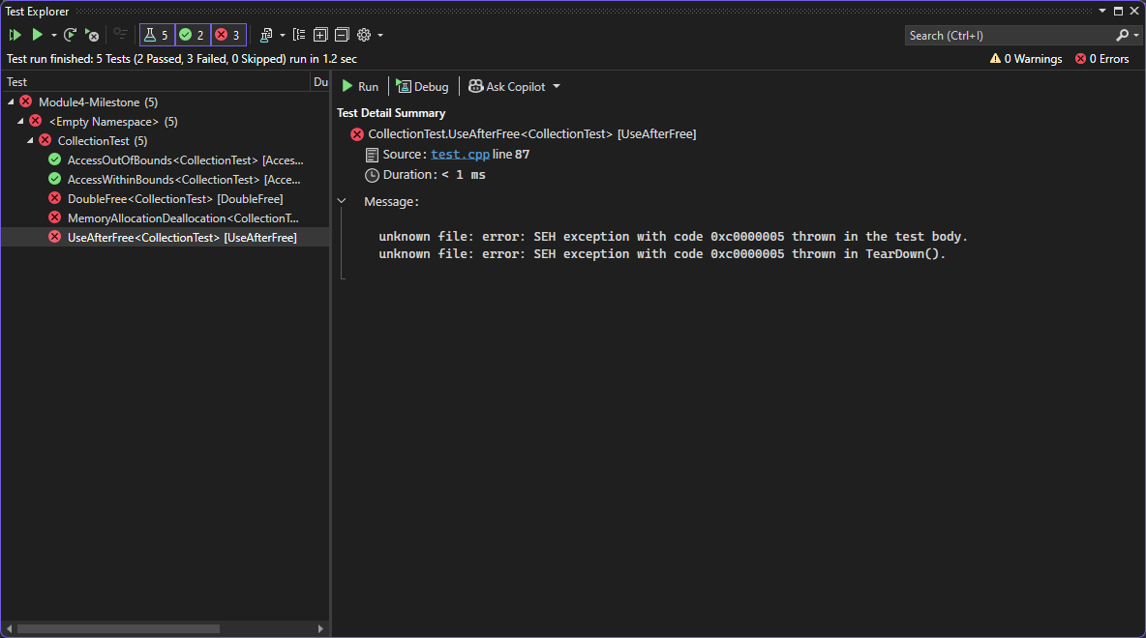

Unit Testing
Unit Test - DoubleFree
To verify that a double free error is prevented.
Test with different types of smart pointers and objects.

Slide 13


AUTOMATION SUMMARY
Build Stage
Verify and Test Stage
Deploy Stage
Monitor and Detect Stage
Respond Stage

Slide 14

TOOLS
The DevSecOps pipeline represents a continuous cycle of building, testing, deploying, and monitoring software, with security integrated at every stage. This approach ensures that security it not an afterthought but an integral part of the development process.
Tools
Threat Modeling Tools
National Vulnerability Database
Common Vulnerabilities and Exposures
Static Analysis Tools
SonarQube, Coverity, Clang Static Analyzer
Static Application Security Testing
Dependency Checkers
OWASP Dependency Check
Dynamic Analysis Tools
Valgrind, AddressSanitizer
Configuration Management
Ansible, Puppet
Security Information and Event Management
Splunk, QRadar

Slide 15

RISKS AND BENEFITS
Problems
Code Vulnerabilities
Lack of Standardization
Inadequate Security Automation
Lack of Security Awareness
Solutions
Implement Secure Coding Standards
Automate Security Checks
Increase Security Awareness
Prioritize Remediation
Benefits
Reduced risk of security breaches
Improved code quality and security
Increased developer productivity
Enhanced reputation and customer trust
Risks
Implementation costs and effort
Potential disruption to existing development processes
Resistance from developers who are not used to secure coding practices

Slide 16

RECOMMENDATIONS
Gap Analysis
Primarily focuses on traditional coding vulnerabilities
Mobile Security
Cloud Security
AI/ML Security
Future-Proofing
Regularly review and update the policy
Adopt a risk-based approach
Incorporate security into the design phase
Promote a culture of security
Specific Recommendations
Develop a mobile security policy that addresses security considerations
Update the policy to include security measures for cloud environments
Research and incorporate security measures for AI/ML systems
Adopt industry recognized security standards (OWASP, NIST, SANS)

Slide 17

CONCLUSIONS
Key Takeaways
Security is an ongoing process
A comprehensive security policy is essential
Security should be integrated into every stage of the SDLC
Promote a culture of security within the development team
Call to Action
Encourage developers to familiarize themselves with the security policy
Report any potential vulnerabilities to the security team
Final Thoughts

Slide 18

REFERENCES
CERT. (2023). SEI CERT Coding Standards. Retrieved from https://wiki.sei.cmu.edu/confluence/display/c/SEI+CERT+Coding+Standards
Schneier, B. (1996). Applied Cryptography: Protocols, Algorithms, and Source Code in C (2nd ed.). John Wiley & Sons.
RFC 2196. (1997). Site Security Handbook. Retrieved from https://datatracker.ietf.org/doc/html/rfc2196
Google Test. (2023). Google Test Documentation. Retrieved from https://google.github.io/googletest/
Kim, G., Behr, K., & Spafford, G. (2013). The Phoenix Project: A Novel About IT, DevOps, and Helping Your Business Win. IT Revolution Press.

